Slide 1
Proofs Involving Sets
Chapter 8

Slide 2
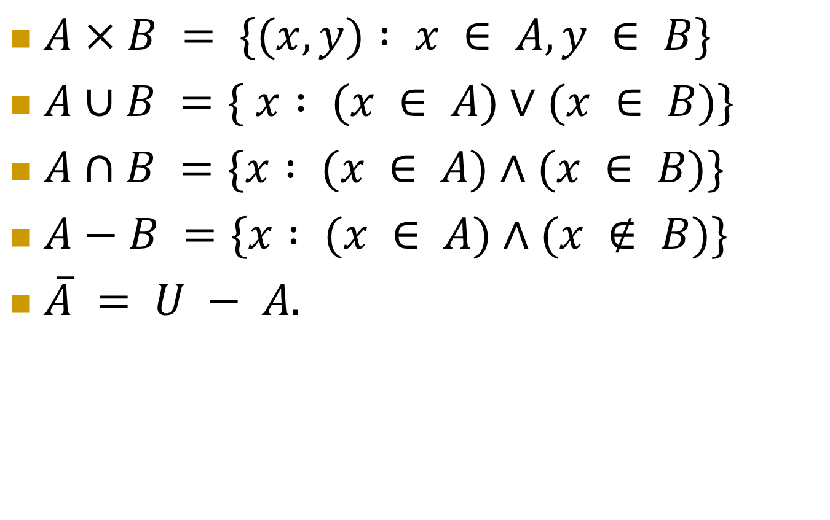
Review: Basic Set Operations
$A×B = \{(x, y) : x ∈ A, y ∈ B\}$
$A∪B =\{ x : (x ∈ A)∨(x ∈ B)\}$
$A∩B =\{x : (x ∈ A)∧(x ∈ B)\}$
$A−B =\{x : (x ∈ A)∧(x ∉ B)\}$
$\overline{A} = U − A.$

Slide 3
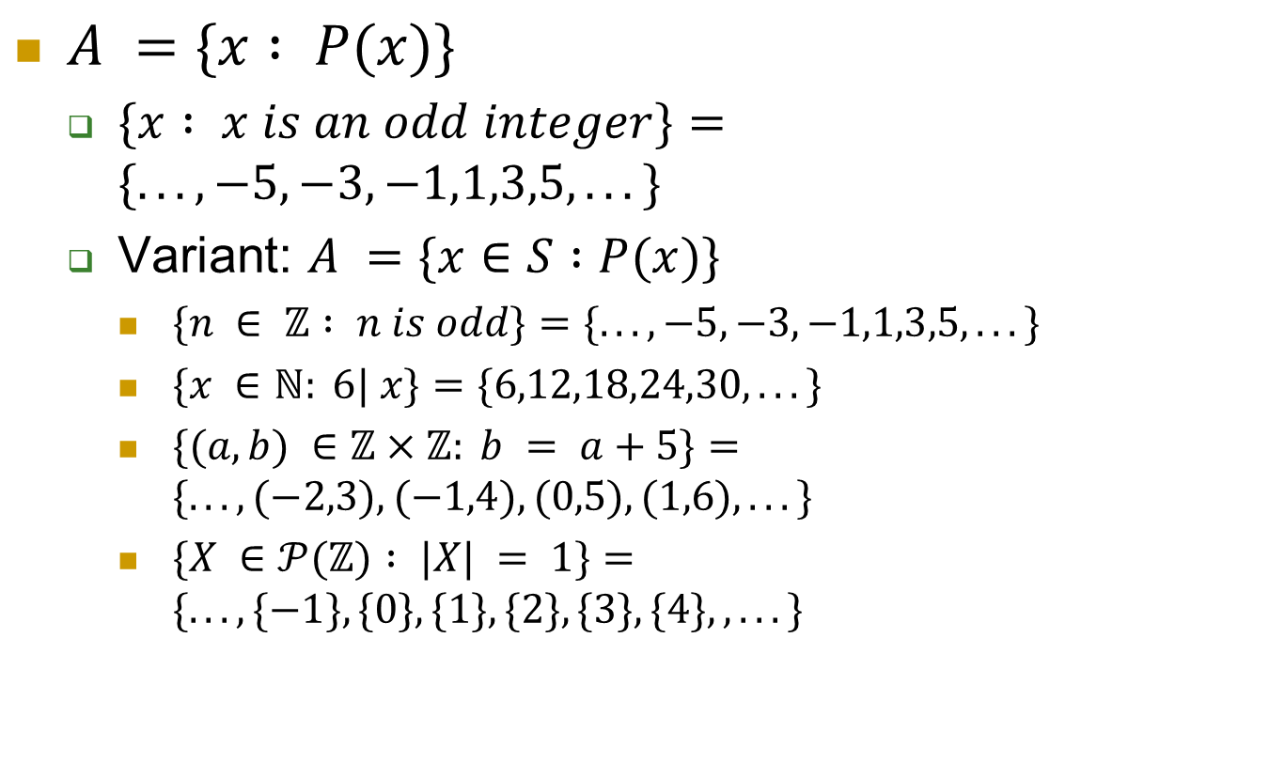
Set Builder Notation
$A =\{x : P(x)\}$
$\{x : x is an odd integer\}=\{. . . ,−5,−3,−1,1,3,5, . . .\}$
Variant: $A =\{x∈S :P(x)\}$
$\{n ∈ ℤ : n is odd\}=\{. . . ,−5,−3,−1,1,3,5, . . .\}$
$\{x ∈ℕ: 6| x\}=\{6,12,18,24,30, . . .\}$
$\{(a,b) ∈ℤ×ℤ: b = a+5\}=\{. . . , (−2,3), (−1,4),(0,5),(1,6), . . .\}$
$\{X ∈𝒫(ℤ) : |X| = 1\}=\{. . . ,\{−1\},\{0\},\{1\},\{2\},\{3\},\{4\},, . . .\}$

Slide 4
Schemas: Set Membership

Slide 5
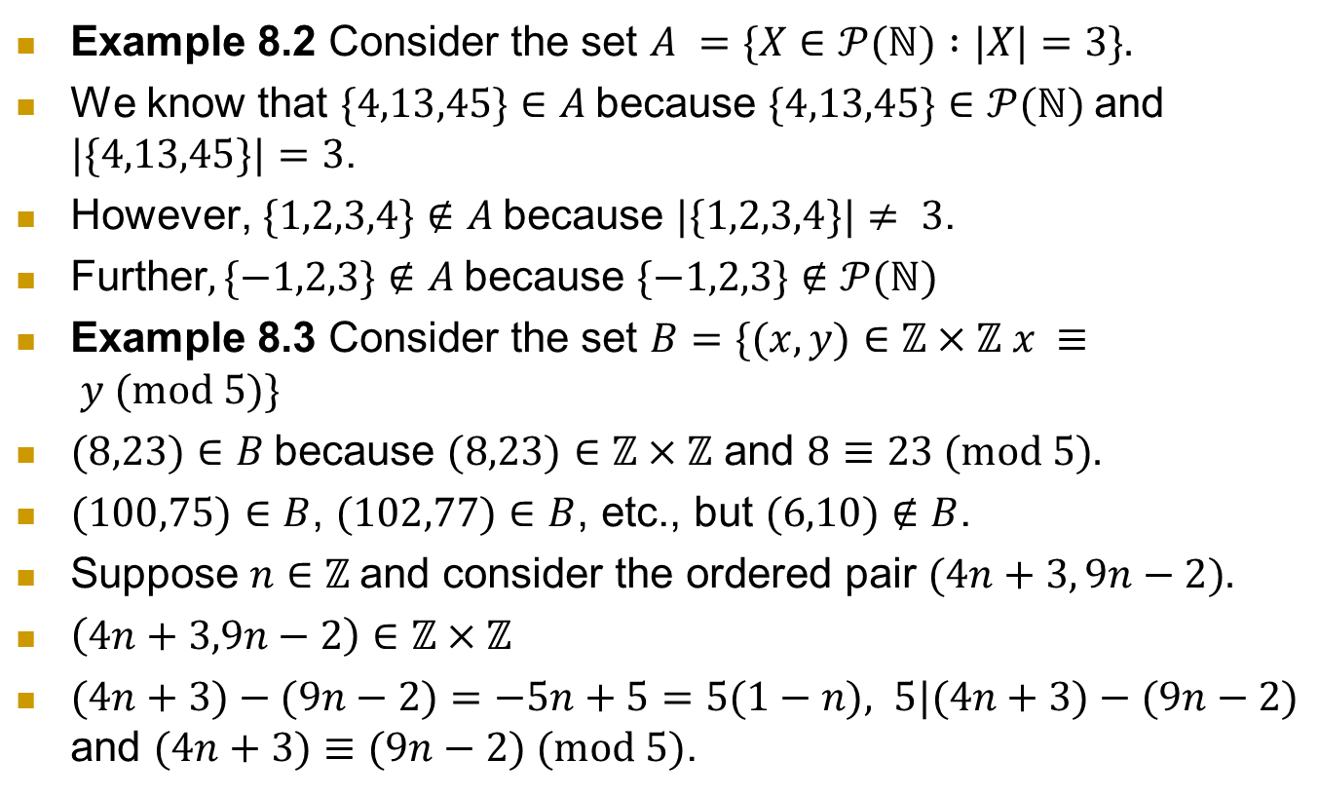
Examples
Example 8.2 Consider the set $A =\{X∈𝒫(ℕ) :|X|=3\}.$
We know that $\{4,13,45\}∈A$because $\{4,13,45\}∈𝒫(ℕ)$and $|\{4,13,45\}|=3$.
However, $\{1,2,3,4\}∉A$because $|\{1,2,3,4\}|≠ 3$.
Further$, \{−1,2,3\}∉A$because $\{−1,2,3\}∉𝒫(ℕ)$
Example 8.3 Consider the set $B=\{(x, y)∈ℤ×ℤ x ≡ y (mod 5)\}$
$(8,23)∈B$because $(8,23)∈ℤ×ℤ$ and $8≡23 (mod 5).$
$(100,75)∈B$, $(102,77)∈B$, etc., but $(6,10)∉B$.
Suppose $n∈ℤ$and consider the ordered pair $(4n+3, 9n−2).$
$\left(4n+3,9n−2\right)∈ℤ×ℤ$
$(4n+3)−(9n−2)=−5n+5=5(1−n), 5|(4n+3)−(9n−2)$ and $(4n+3)≡(9n−2) (mod 5)$.

Slide 6
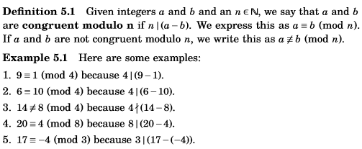
Congruence of Integers
In practical terms, a≡b (mod n) means that a and b have the same remainder when divided by n

Slide 7

Proving $A⊆B$
If A and B are sets, then A ⊆ B means that every element of A is also an element of B.
Equivalently: If a ∈ A, then a ∈ B.
To prove that A ⊆ B, we just need to prove that the conditional statement
“If a ∈ A, then a ∈ B”
is true.

Slide 8
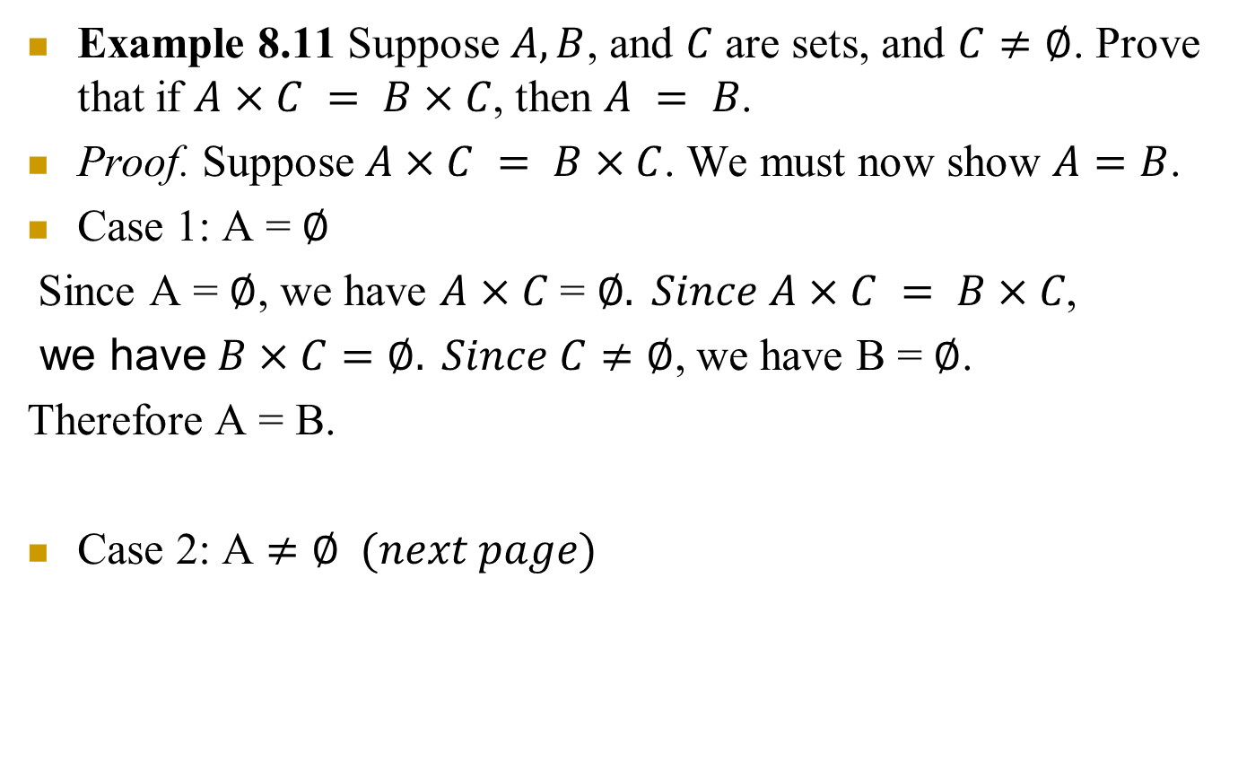
Example
Example 8.11 Suppose $A, B$, and $C$ are sets, and $C≠∅$. Prove that if $A×C = B×C$, then $A = B$.
Proof. Suppose $A×C = B×C$. We must now show $A=B$.
Case 1: A = $∅$
Since A = $∅$, we have $A×C$ = $∅. Since A×C = B×C\text{,}$
we have$B×C=∅. Since C≠∅$, we have B = $∅$.
Therefore A = B.
Case 2: A $≠∅ (next page)$

Slide 9
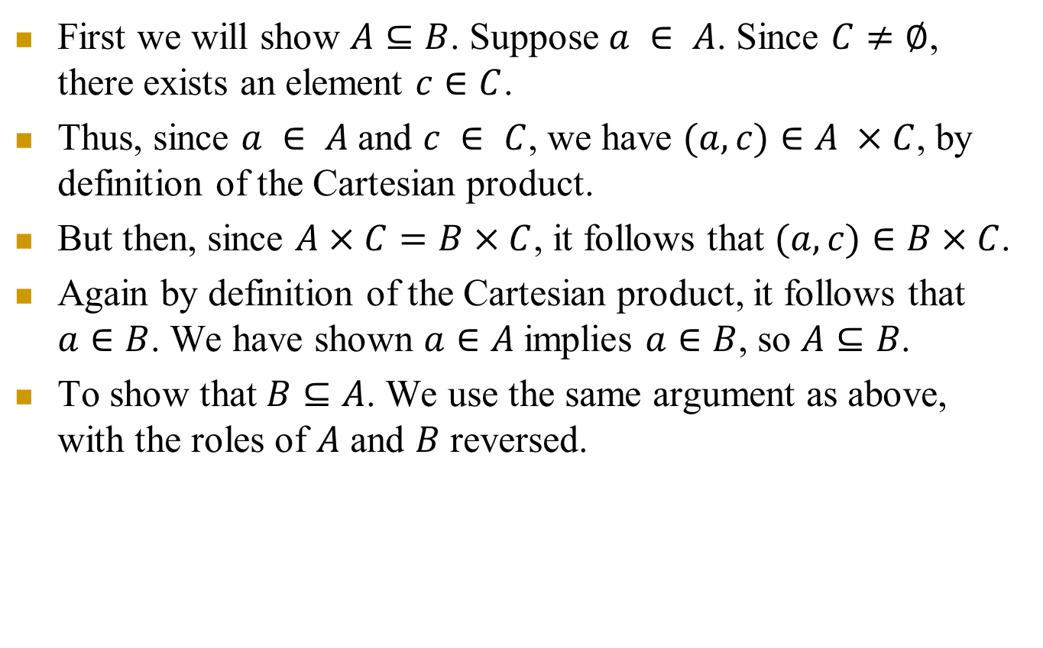
Example
First we will show $A⊆B$. Suppose $a ∈ A$. Since $C≠∅$, there exists an element $c∈C$.
Thus, since $a ∈ A$and $c ∈ C$, we have $(a, c)∈A ×C$, by definition of the Cartesian product.
But then, since $A×C=B×C$, it follows that $(a, c)∈B×C$.
Again by definition of the Cartesian product, it follows that $a∈B$. We have shown $a∈A$implies $a∈B$, so $A⊆B$.
To show that $B⊆A$. We use the same argument as above, with the roles of $A$ and $B$ reversed.

Slide 10
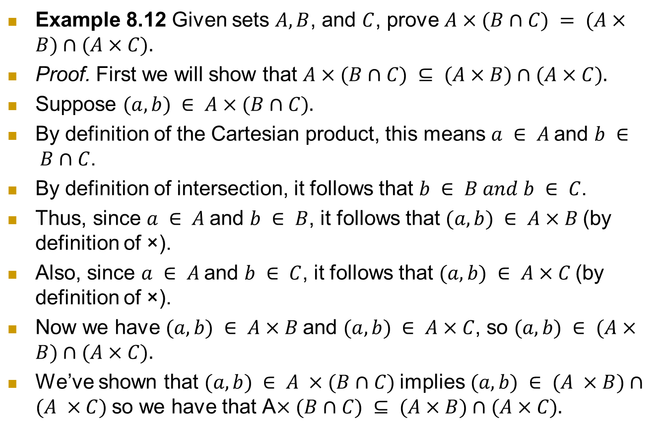
Example
Example 8.12 Given sets $A, B$, and $C$, prove $A×(B∩C) = (A×B)∩(A×C).$
Proof. First we will show that $A×(B∩C) ⊆ (A×B)∩(A×C).$
Suppose $(a,b) ∈ A×(B∩C).$
By definition of the Cartesian product, this means $a ∈ A$and $b ∈ B∩C$.
By definition of intersection, it follows that $b ∈ B and b ∈ C$.
Thus, since $a ∈ A$and $b ∈ B$, it follows that $(a,b) ∈ A×B$(by definition of ×).
Also, since $a ∈ A$and $b ∈ C$, it follows that $(a,b) ∈ A×C$(by definition of ×).
Now we have $(a,b) ∈ A×B$and $(a,b) ∈ A×C$, so $(a,b) ∈ (A×B)∩(A×C).$
We’ve shown that $(a,b) ∈ A ×(B∩C)$implies $(a,b) ∈ (A ×B)∩(A ×C)$so we have that A$×(B∩C) ⊆ (A×B)∩(A×C).$

Slide 11
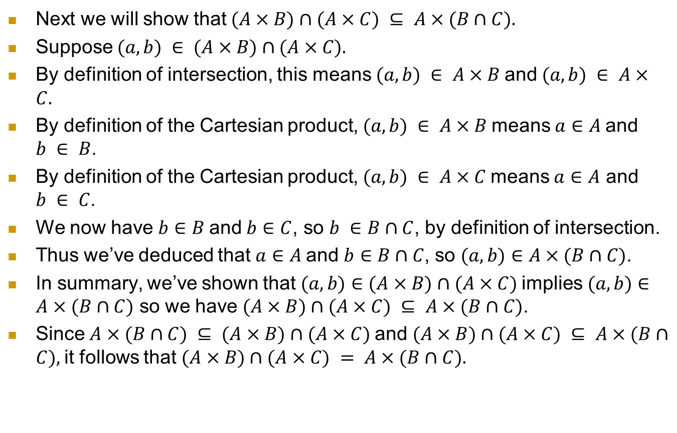
Example
Next we will show that $(A×B)∩(A×C) ⊆ A×(B∩C).$
Suppose $(a,b) ∈ (A×B)∩(A×C).$
By definition of intersection, this means $(a,b) ∈ A×B$and $(a,b) ∈ A×C.$
By definition of the Cartesian product, $(a,b) ∈ A×B$means $a∈A$and $b ∈ B$.
By definition of the Cartesian product, $(a,b) ∈ A×C$means $a∈A$ and $b ∈ C$.
We now have $b∈B$and $b∈C$, so $b ∈B∩C$, by definition of intersection.
Thus we’ve deduced that $a∈A$and $b∈B∩C$, so $(a,b)∈A×(B∩C)$.
In summary, we’ve shown that $(a,b)∈(A×B)∩(A×C)$implies$(a,b)∈A×(B∩C)$ so we have $(A×B)∩(A×C) ⊆ A×(B∩C)$.
Since $A×(B∩C) ⊆ (A×B)∩(A×C)$and $(A×B)∩(A×C) ⊆ A×(B∩C),$it follows that $(A×B)∩(A×C) = A×(B∩C).$

Slide 12
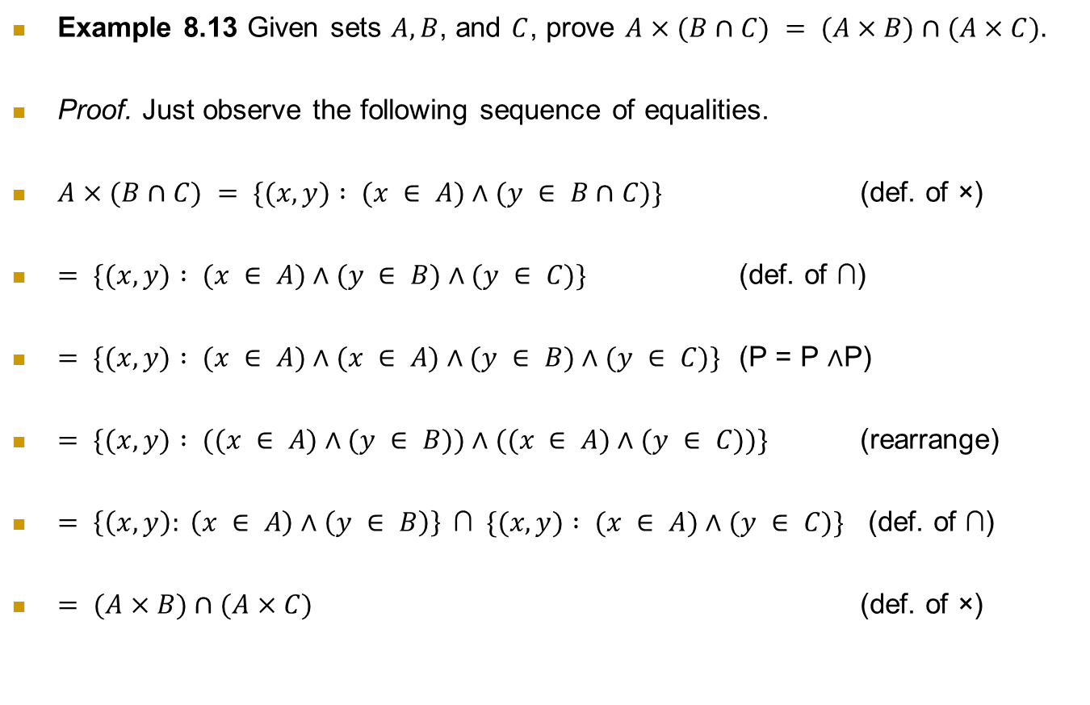
Example
Example 8.13 Given sets $A, B$, and $C$, prove $A×(B∩C) = (A×B)∩(A×C).$
Proof. Just observe the following sequence of equalities.
$A×(B∩C) = \{(x, y) : (x ∈ A)∧(y ∈ B∩C)\}$ (def. of ×)
$= \{(x, y) : (x ∈ A)∧(y ∈ B)∧(y ∈ C)\}$ (def. of ∩)
$= \{(x, y) : (x ∈ A)∧(x ∈ A)∧(y ∈ B)∧(y ∈ C)\}$ (P = P ∧P)
$= \{(x, y) : ((x ∈ A)∧(y ∈ B))∧((x ∈ A)∧(y ∈ C))\}$ (rearrange)
$= \left\{\left(x, y\right): \left(x ∈ A\right)∧\left(y ∈ B\right)\right\}$∩$\{(x, y) : (x ∈ A)∧(y ∈ C)\}$ (def. of ∩)
$= (A×B)∩(A×C)$ (def. of ×)

Slide 13
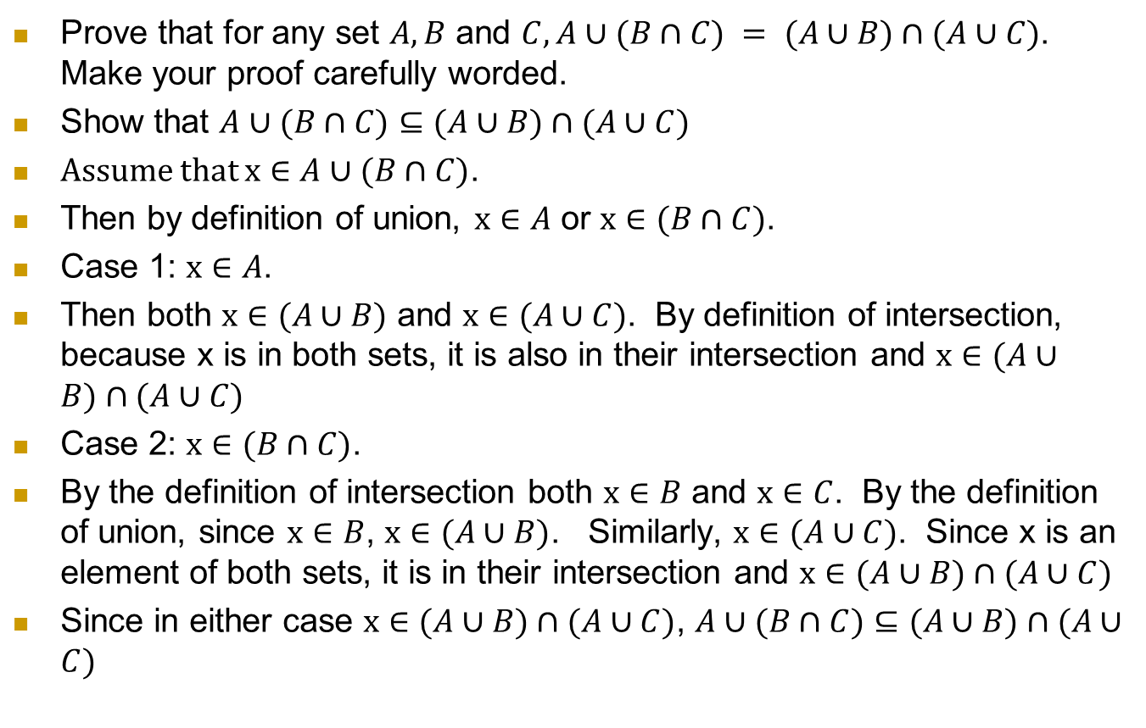
Example
Prove that for any set $A, B$ and $C, A∪(B∩C) = (A∪B)∩(A∪C)$. Make your proof carefully worded.
Show that $A∪(B∩C)⊆(A∪B)∩(A∪C)$
Assume that $x∈A∪(B∩C)$.
Then by definition of union, $x∈A$ or $x∈(B∩C)$.
Case 1: $x∈A$.
Then both $x∈(A∪B)$ and $x∈(A∪C)$. By definition of intersection, because x is in both sets, it is also in their intersection and $x∈(A∪B)∩(A∪C)$
Case 2: $x∈(B∩C)$.
By the definition of intersection both $x∈B$ and $x∈C$. By the definition of union, since $x∈B$, $x∈(A∪B)$. Similarly, $x∈(A∪C)$. Since x is an element of both sets, it is in their intersection and $x∈(A∪B)∩(A∪C)$
Since in either case $x∈(A∪B)∩(A∪C)$, $A∪(B∩C)⊆(A∪B)∩(A∪C)$

Slide 14
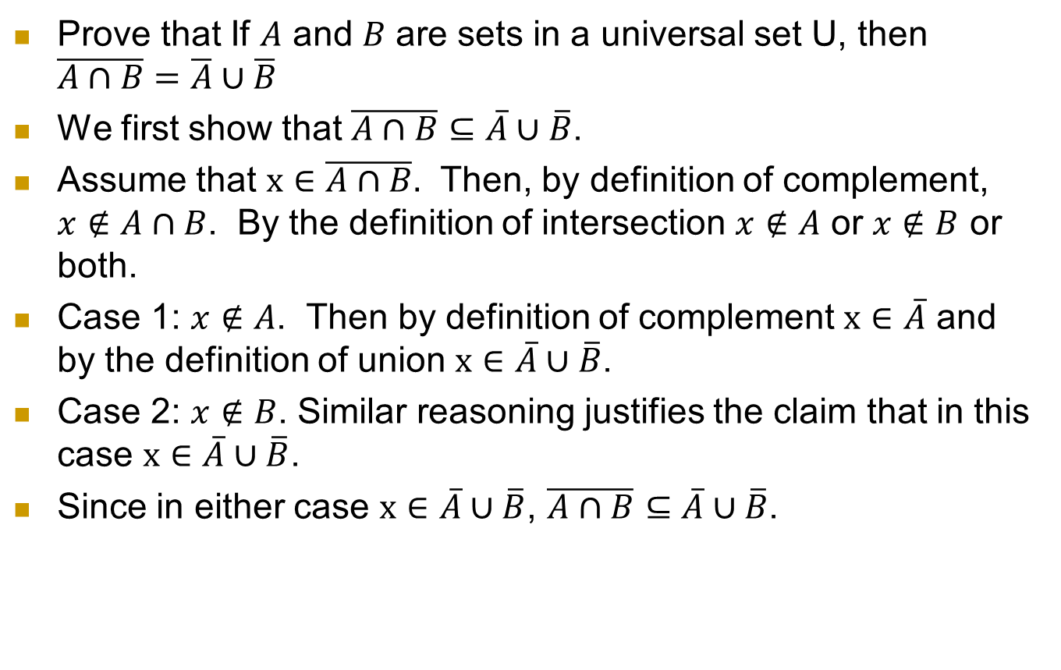
In Class Exercise 1.
Prove that If $A$ and $B$ are sets in a universal set U, then $\overline{A∩B}=\overline{A}∪\overline{B}$
We first show that $\overline{A∩B}⊆\overline{A}∪\overline{B}$.
Assume that $x∈\overline{A∩B}.$ Then, by definition of complement, $x∉A∩B$. By the definition of intersection $x∉A$ or $x∉B$ or both.
Case 1: $x∉A$. Then by definition of complement $x∈\overline{A}$ and by the definition of union $x∈\overline{A}∪\overline{B}$.
Case 2: $x∉B$. Similar reasoning justifies the claim that in this case $x∈\overline{A}∪\overline{B}$.
Since in either case $x∈\overline{A}∪\overline{B}$, $\overline{A∩B}⊆\overline{A}∪\overline{B}$.

